Slide 1
HUMAN ACTIVITY RECOGNITION USING MACHINE LEARNING TECHNIQUES (MHRD 34)
PIP104 University Project-II
Batch Number: CST07
Roll Number | Student Name
20201CST0003 | Mohammed Zaid Khan
20201CST0038 | Ankita Yeleswarapu
20201CST0039 | Jeevan R.
Under the Supervision of,
Mr. Lakshmisha S Krishna
Assistant Professor
School of Computer Science & Engineering
Presidency University

Slide 2
Introduction
Human Activity Recognition (HAR) has emerged as a pivotal research area in various fields ranging from technical to medical.
The ability to automatically identify and interpret human activities from sensor data holds tremendous potential across a multitude of applications, ranging from healthcare and assistive technologies to security, smart environments, and beyond. As our world becomes increasingly connected and data-rich, the demand for systems capable of understanding and responding to human behavior has grown exponentially.

Slide 3
Literature Review
SL NO. | AUTHOR NAME AND YEAR | TITLE | FINDINGS
1 | H. Yang, X. Wen, Y. Geng, Y. Wang, X. Wang and C. Lu,(2022) | A Multi-Position Joint Angle Dataset for Human Activity Recognition Using Wearable Sensors | Methods that reliably recognize a variety of human actions, underscoring the potential of wearable sensor technologies for reliable activity.
2 | F. Zhou, R. Wang, H. Su and S. Xu(2022) | A Human Activity Recognition Model Based on Wearable Sensor | The combination of CNN and RNN architectures enhances the model's ability to recognize and classify specific actions in the dataset.
3 | I. Stolovas, S. Suárez, D. Pereyra, F. De Izaguirre and V. Cabrera(2021) | Human activity recognition using machine learning techniques in a low-resource embedded system, | To successfully forecast activities from accelerometer data, the system makes use of statistical properties, dimensionality reduction (Linear Discriminant Analysis), and SVM classification.
4 | Q. Jian, S. Guo, P. Chen, P. Wu and G. Cui(2021 ) | A Robust Real-time Human Activity Recognition method Based on Attention-Augmented GRU | AASC surpasses traditional GRU models in terms of accuracy and robustness by leveraging attention processes to facilitate efficient temporal connection learning .
5 | M. Atikuzzaman, T. R. Rahman, E. Wazed, M. P. Hossain and M. Z. Islam(2020) | Human Activity Recognition System from Different Poses with CNN, | Obtained excellent scores for pose and activity detection accuracy. The stated processing speed is significant since it suggests real-time application potential.

Slide 4
Literature Review
SL NO. | AUTHOR NAME AND YEAR | TITLE | FINDINGS
6 | N. Amin Choudhury, S. Moulik and S. Choudhury(2020) | Cloud-based Real-time and Remote Human Activity Recognition System using Wearable Sensors | Could correctly classify different human activities at a rate of nine, which is especially useful when taking wearables and cloud computing .
7 | R. Saini and V. Maan(2020) | Human Activity and Gesture Recognition: A Review, | CNNs have demonstrated success in accurately recognizing a variety of human actions.
8 | M. S. H. Bhuiyan, N. S. Patwary, P. K. Saha and M. T. Hossain(2020) | Sensor-Based Human Activity Recognition: A Comparative Study of Machine Learning Techniques, | Combining (PCA) with (RF) on phone accelerometer data produced the best results in terms of HAR accuracy.
9 | L. Xie, J. Tian, G. Ding and Q. Zhao(2018) | Human activity recognition method based on inertial sensor and barometer, | The testing results, which accurately detect human activities based on the given sensor data, show how effective the system is.
10 | E. Kim, S. Helal and D. Cook(2010) | Human Activity Recognition and Pattern Discovery | The study distinguishes between broad systems that recognize activity using predetermined models and those that use sensor data analysis.

Slide 5
Proposed Method
1. Data Importing: Open the UCF101 dataset and load the video clips for each of the 101 action categories. Form image patterns by taking the frames out of the video footage. This would be regarded for specific applications.
2. Extraction of Features and choosing appropriate CNN model for classification: Features are extracted from the dataset in accordance to the model. The most suitable architecture for video classification is CNN I3D (Inflated 3D CNNs) and is hence used.
3. Training the data: The dataset used for training the data is UCF101. Hence, we check the labeling of the data with the use of Kinetics and hence display it for ease access.
4. Testing the data: The trained model is tested with the use of sample videos which then displays the probabilistic percentage of the possible labels associated with the video. The one with the highest probability is associated with the video and is hence verified.

Slide 6
Objectives
Develop CNN-based models with the primary objective of improving the accuracy and recognition rates in human activity recognition, ensuring more precise identification of various activities.
Design CNN architectures that exhibit robustness to environmental conditions, such as changes in lighting, background, and different sensor configurations.
Prioritize the optimization of CNN models for real-time processing to address latency challenges associated with streaming sensor data.
Create CNN models capable of effectively recognizing a broad spectrum of human activities, promoting versatility and applicability in various contexts and scenarios.
Investigate the application of transfer learning to leverage pre-trained CNN models on large datasets, potentially enhancing the performance of HAR models. This aims to capitalize on learned features from diverse sources and domains.

Slide 7
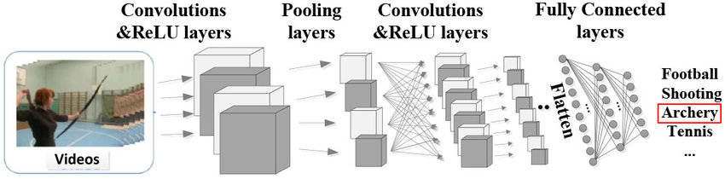
Methodology
Fig: CNN Architecture Model

Slide 8
Methodology
1. Firstly, the UCF101 dataset is downloaded and preprocessing is performed. This ensures that the data from the video is well segmented into required and desirable frames and clip length. Kinetics URL is used to authorize and label the data.
2. Perform data preprocessing steps, such as resizing frames, normalizing pixel values, and potentially extracting optical flow or other relevant features. Split the dataset into training, validation, and test sets.
3. CNN Model I3D is chosen for performing classification. This helps in reducing complexity and showcases rigid classification tasks within the video sequence.
4. Here, we use UCF101 dataset and hence the model is already trained. However, we fine tune the dataset for adaptability by further initializing pre-trained weights. The use of Kinetics is made as it simplifies the task.
5. The CNN model is then tested post training on the designated test data.

Slide 9
Timeline of Project
Review 0
Planning
Review 2
Design
Review 1
Research
Review 4
Final
Review 3
Implmentation

Slide 10
Outcomes
The CNN-based model I3D model yield higher accuracy in recognizing and classifying diverse human activities, contributing to more reliable and precise outcomes, specialized for a 3D environment i.e. video clips.
The utilization of CNN architectures has aided to enhance the adaptability of human activity recognition systems across varied environments, scenarios, and activity types incorporated in UCF101 dataset.
Optimizing the model for real-time processing efficiency has enabled quicker and more responsive recognition of human activities while enhancing the practical utility of the developed model.
Successful implementation of CNN models is likely to result in better generalization across a wide spectrum of human activities, ensuring versatility and applicability in different contexts.
The model demonstrates reduced reliance on manually engineered features while allowing for more automatic and adaptable feature learning directly from raw sensor data,
The developed CNN demonstrates advancements in accuracy, efficiency, and adaptability compared to existing state-of-the-art methods in human activity recognition, especially with the use of images datasets.

Slide 11
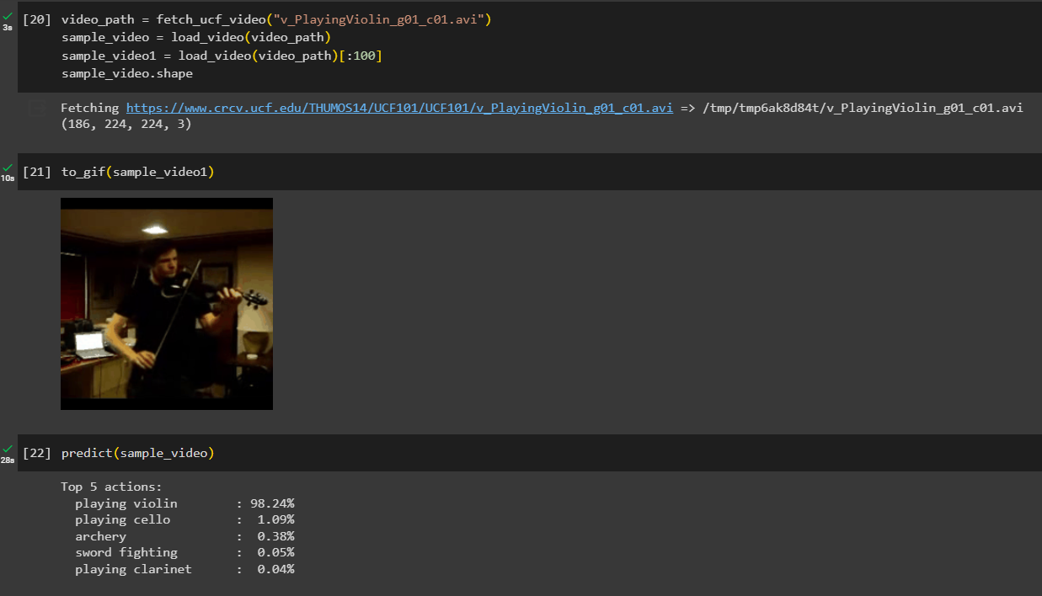
Outcomes
Fig 1.2: Testing the model for “Playing Violin” from UCF101 dataset. Result is satisfactory.
Accuracy obtained: 99.24%

Slide 12
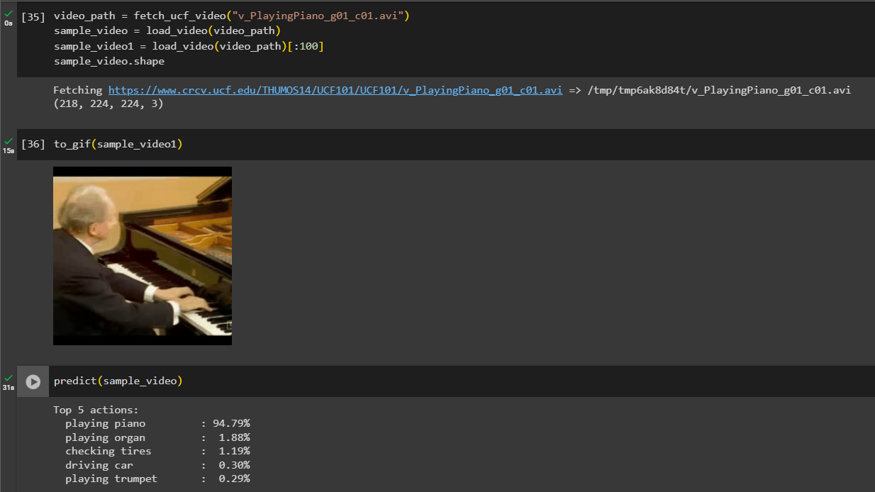
Outcomes
Fig 1.2: Testing the model for “Playing Piano” from UCF101 dataset. Result is satisfactory.
Accuracy obtained: 94.7%

Slide 13
Conclusion
The findings of this study highlight the potential of CNN architectures to boost recognition accuracy, encapsulate temporal dynamics, and minimize emphasis on handcrafted attributes.
The proposed model is more resistant to environmental alterations and have a greater ability to generalize over a broad spectrum of human activities.
Furthermore, research into multimodal sensor fusion and an emphasis on interpretability contribute to the overall progress of HAR with CNNs.
As the model is adaptable, users and researchers can obtain useful insights into how the model makes its predictions, increasing transparency and confidence in the system's decision-making process, which is especially crucial for applications requiring human trust.
The implementation of transfer learning enhances the ability of the model to adapt to the intricate nature of UCF101's activity classes by utilizing pre-trained weights.

Slide 14
References
[1] I. Stolovas, S. Suárez, D. Pereyra, F. De Izaguirre and V. Cabrera, "Human activity recognition using machine learning techniques in a low-resource embedded system," 2021 IEEE URUCON, Montevideo, Uruguay, 2021, pp. 263-267, doi: 10.1109/URUCON53396.2021.9647236.
[2] E. Kim, S. Helal and D. Cook, "Human Activity Recognition and Pattern Discovery," in IEEE Pervasive Computing, vol. 9, no. 1, pp. 48-53, Jan.-March 2010, doi: 10.1109/MPRV.2010.7.
[3] F. Zhou, R. Wang, H. Su and S. Xu, "A Human Activity Recognition Model Based on Wearable Sensor," 2022 9th International Conference on Digital Home (ICDH), Guangzhou, China, 2022, pp. 169-174, doi: 10.1109/ICDH57206.2022.00033.
[4] M. Atikuzzaman, T. R. Rahman, E. Wazed, M. P. Hossain and M. Z. Islam, "Human Activity Recognition System from Different Poses with CNN," 2020 2nd International Conference on Sustainable Technologies for Industry 4.0 (STI), Dhaka, Bangladesh, 2020, pp. 1-5, doi: 10.1109/STI50764.2020.9350508.
[5] L. Xie, J. Tian, G. Ding and Q. Zhao, "Human activity recognition method based on inertial sensor and barometer," 2018 IEEE International Symposium on Inertial Sensors and Systems (INERTIAL), Lake Como, Italy, 2018, pp. 1-4, doi: 10.1109/ISISS.2018.8358140.

Slide 15
References
[6] F. Yang, X. Wen, Y. Geng, Y. Wang, X. Wang and C. Lu, "MPJA-HAD: A Multi-Position Joint Angle Dataset for Human Activity Recognition Using Wearable Sensors," 2022 International Conference on Advanced Mechatronic Systems (ICAMechS), Toyama, Japan, 2022, pp. 178-182, doi: 10.1109/ICAMechS57222.2022.10003441.
[7] Q. Jian, S. Guo, P. Chen, P. Wu and G. Cui, "A Robust Real-time Human Activity Recognition method Based on Attention-Augmented GRU," 2021 IEEE Radar Conference (RadarConf21), Atlanta, GA, USA, 2021, pp. 1-5, doi: 10.1109/RadarConf2147009.2021.9455322.
[8] L. Amin Choudhury, S. Moulik and S. Choudhury, "Cloud-based Real-time and Remote Human Activity Recognition System using Wearable Sensors," 2020 IEEE International Conference on Consumer Electronics - Taiwan (ICCE-Taiwan), Taoyuan, Taiwan, 2020, pp. 1-2, doi: 10.1109/ICCE-Taiwan49838.2020.9258050.
[9] Q. Saini and V. Maan, "Human Activity and Gesture Recognition: A Review," 2020 International Conference on Emerging Trends in Communication, Control and Computing (ICONC3), Lakshmangarh, India, 2020, pp. 1-2, doi: 10.1109/ICONC345789.2020.9117535.

Slide 16
Thank You

